Slide 1

Introduction to Python
Notes:
Welcome to Programming I Lecture 2 on Introduction to Python

Slide 2
Objectives
At the end of this lecture, you will be able to
Use IDLE for programming Python
Recognize and use the components in Python
Understand the usage of variables in Python
Notes:
At the end of this lecture, you will be able to:
Use IDLE (Integrated DeveLopment Environment) as our programming environment for Python
Recognize and use the components in Python
Understand the usage of variables in Python

Slide 3
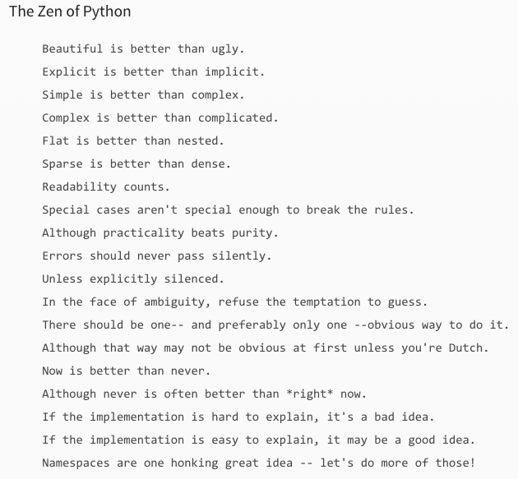
Python

Slide 4

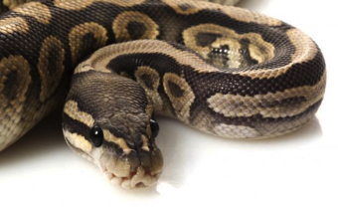
What is Python?
A programming language with a set of libraries
Developed in early 1990s by Guido van Rossum
Characteristics:
Easy to read and learn
Clean look with few unnecessary symbols
Easy to keep up to date
Notes:
Python is a general purpose and high level programming language with a comprehensive set of libraries. You can use Python for developing desktop Graphical User Interface (GUI) applications, websites and web applications.
Developed in early 1990s by Guido van Rossum, Python allows you to focus on core functionality of the application by taking care of common programming tasks. The simple syntax rules of the programming language further makes it easier for you to keep the code base readable and application maintainable.

Slide 5
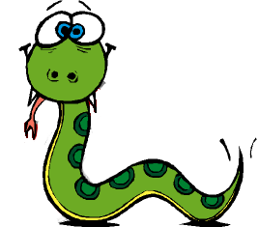
What is Python useful for?
Scripting
Short programs to perform administrative tasks
Website development
E.g.: Django, Zope
Text processing
Handling text and files
Education
Fast becoming the first language to learn around the world (EG: NUS, Cambridge, CMU, MIT, etc...)

Slide 6

Using IDLE with Python
Simple editor for beginners
Packaged with Python installation
Others exist: Notepad++, Sublime, etc.
Let’s install Python!
Notes:
Using IDLE with Python
We will be using IDLE (Integrated DeveLopment Environment) as our programming environment. IDLE is bundled with Python and is installed as part of the Python installation.
You can refer to the Python Installation Guide in MEL to install the software.

Slide 7
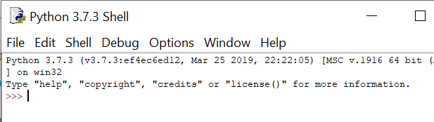
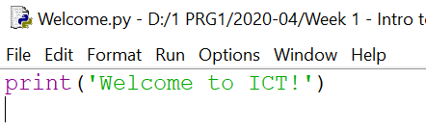

Using IDLE
Let’s do this together
Launch IDLE
Choose 'File' -> 'New Window' (or CTL-N)
Type the following
Save your program by choosing 'File' -> 'Save' (or CTL-S).
Save on your desktop as 'welcome.py'
Run your program by choosing 'Run' -> 'Run Module' (or F5)
A Python shell will appear with your statement
print('Welcome to ICT!')
Notes:
Using IDLE
If you have installed IDLE successfully, you can try out this simple exercise to create a Python program.
Follow the steps accordingly to print out the statement: 'Welcome to ICT!'
Note:
Python is case-sensitive. Capital letter 'A' is different from small letter 'a'.
Check your codes carefully

Slide 8
IDLE
Useful shortcuts
Command | What it does
CTL-N | Opens new editor window
CTL-O | Opens file for editing
CTL-S | Save current program
F5 | Run current program
CTL-Z | Undo last action

Slide 9
Syntax & Programming Structure
Syntax (Rules)
Languages have rules, e.g. English: full-stop to end sentence, commas for breaks in sentence, etc.
Programming languages also have rules or syntax.
Program Structure (Format)
Languages have formats, e.g. writing letters, writing memos, reports, etc.
Programming languages also have formats or program structure to follow when writing a program
Notes:
Syntax or Rules of Programming Languages
All languages have rules, e.g. for English language, a full-stop is needed to end a sentence, commas are required for breaks in a sentence, etc.
Similarly, programming languages also have rules or syntax. In computer science, the syntax of a computer language is the set of rules that defines the combinations of symbols that are considered to be a correctly structured document or fragment in that language.
The syntax of the Python programming language is the set of rules which defines how a Python program will be written.
Programming Structure
Languages have formats to follow, e.g. formats for writing letters, writing memos, reports, etc.
Programming languages also have its own format or program structure to follow when writing a program. This differ depending on the programming language used.
We will see more of the syntax and the programming structure as we investigate the components of Python.

Slide 10
Components
in
Python

Slide 11
Identifiers
Identifiers
names defined by the programmer
case-sensitive
begin with lowercase letter
cannot begin with a digit
contain only letters, digit and/or the underscore
should have meaningful names
identifier
Notes:
Identifiers
Python identifiers are user-defined names defined by the programmer. They are used to define entities in the Python programs.
The following rules apply to the Python identifier:
All identifier names in Python are case sensitive. This means that a uppercase letter 'B' is different from lowercase letter 'b'. So, you must be careful while using them in your code.
Python identifier name begin with lowercase letter. Python identifier can contain letters in a lowercase letter (a-z), uppercase letter (A-Z), digits (0-9), and underscore (_).
Python identifier name cannot begin with a digit and cannot contain only digits.
Identifier names should be meaningful. We should use proper names to hint the use of the identifier. Follow the rule to “keep it simple and meaningful”.

Slide 12
Reserved Keywords
Reserved Keywords
Special words not allowed for use as identifers
Reserved by Python for special use
False | class | finally | is | return
None | continue | for | lambda | try
True | def | from | nonlocal | while
and | del | global | not | with
as | elif | if | or | yield
assert | else | import | pass
break | except | in | raise
Notes:
Reserved Keywords
Keywords are special words which are reserved and have a specific meaning. Python has a set of keywords that cannot be used as variables in programs.
All keywords in Python are case sensitive. So, you must be careful while using them in your code and to also avoid using them as identifiers . We have just captured here a snapshot of the possible Python keywords.

Slide 13
Example – Valid & Invalid Identifiers
Python Valid Identifiers
ab10c: contains only letters and numbers
abc_DE: contains all the valid characters
_: surprisingly but Yes, underscore is a valid identifier
_abc: identifier can start with an underscore
Python Invalid Identifiers
99: identifier cannot be only digits
9abc: identifier cannot start with number
x+y: the only special character allowed is an underscore
for: it is a reserved keyword

Slide 14


Statements
Statements in Python are separated by a new-line character (return key)
If the statement is too long, you can use a backslash ( \ ) to continue the statement to the next line
output
Notes:
Statements
Statements in Python are separated by a new-line character (return key).
You cannot split a statement into multiple lines in Python by pressing the Enter key. If the statement is too long, you can use a backslash ( \ ) to indicate that a statement is continued on the next line.
This is illustrated in the second print statement in the given example.

Slide 15

Comments
Explains meaning or logic of code
Comments are ignored by computer
Good practice to include following comments
Description of program with date and version number
Programmer’s name and relevant details
For single-line comment, type after the # sign
For multi-line comment, enclose in triple-quote '''
comments
Notes:
Comments
Comments can be used to explain the meaning or logic of Python code. Comments can be used to make the code more readable. These comments are just explanations and are ignored during program execution.
For single-line comment, type after the hash character #. A comment in Python starts with the # , and extends to the end of the physical line.
For multi-line comment, enclose in triple-quote in your code, and place your comment inside it.
Refer to the example on how comments are done.

Slide 16
Values & Data Types
A value is one of the fundamental things — like a letter or a number — that a program manipulates.
These values are classified into different data types
Data Type | Description | Example
int | integer | 46
float | floating point or decimal numbers | 123.45
bool | boolean | True or False
str | sequence of characters | 'A', 'Hello'
Notes:
Values & Data Types
A value is one of the fundamental things, like a letter or a number, that a program manipulates.
In Python and other programming languages, values and data are classified into various data types according to their characteristics and usage.
Data types represent a kind of value which determines what operations can be performed on that data.
Numeric (integer or float), non-numeric (string) and Boolean (true/false) data are the most used data types.

Slide 17
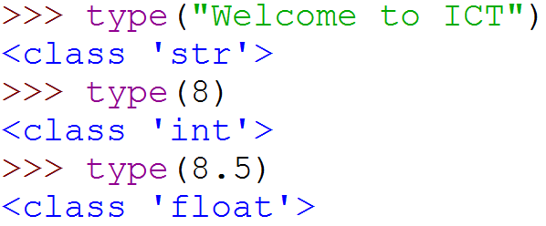
Values and data types
Python has a function called type which can tell you the type of a value.
Strings belong to the class str and integers belong to the class int and float belongs to float
At this stage, you can treat the words class and type interchangeably
Notes:
Python has a function called type which can tell you the type of a value.
Strings belong to the class str and integers belong to the class int and float belongs to float.
Try typing out the statements in the example given at the Python command prompt to see the data type of value. At this stage, you can treat the words class and type interchangeably.

Slide 18
Exercise 1
What is the datatype of the following?
Program Code | Output
>>> print (type(7))
>>> print (type("Welcome"))
>>> print(type(False))
>>> print(type(7.5))
>>> print(type(12/17))
>>> print(type(2.0/1))
Notes:
Exercise 1
Spend some time to complete Exercise 1 to identify the data types for the various values. Countercheck your answer by keying the statement at the Python command prompt to execute the statement.

Slide 19
Exercise 1 (cont)
What is the datatype of the following?
Program Code | Output
>>> print(type(11 ** 3))
>>> print(type(2 == "2"))
>>> a = str((-4 + 3 / 2 ** 3) + 321 - ((64 / 16) % 4) ** 2) >>> print(type(a))

Slide 20
Understanding Variables
Consider this problem
Write a computer program that calculates the BMI of a person. Display result on the screen.
Does this computer program need to remember information?
Yes!
What information does this program need to remember?
values of :
weight, height, calculated bmi
Where does the program store the needed information?
in VARIABLES
Notes:
Variables
A variable is a kind of storage box used to store values, so that these values can be used or altered later in the program.
A variable must have a name, which must be a valid Python identifier as discussed in the earlier slides.
In convention, Python variable names should be meaningful names that reflect the nature of the value stored and begin with a lowercase letter.
You can store a value in a variable, change the contents of a variable, and also retrieve and use a stored value.
For the BMI example done in last lecture, the variables used are the weight, height for storing the values and bmi for storing the calculated result.

Slide 21
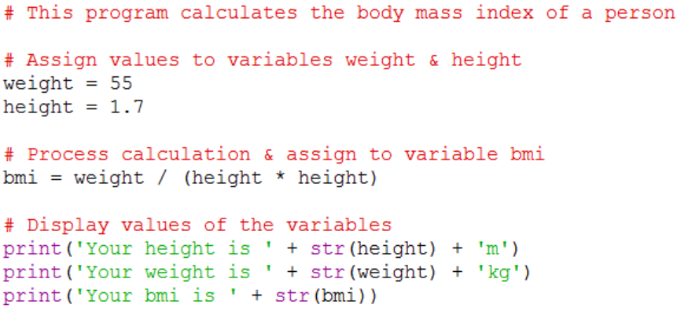
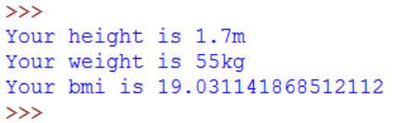
Program - CalBMI.py
Output
What are the variables used in this program?
Notes:
For the program given, the variables used are the weight and height for storing the values 55 and 1.7 respectively and bmi for storing the calculated result.

Slide 22
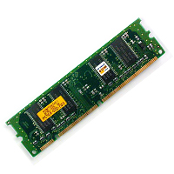
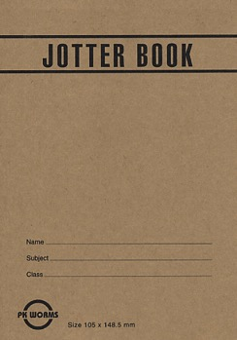
Understanding Variables
Programs use variables to store data
Variables are memory spaces in the computer’s Random Access Memory (RAM)
Imagine RAM as computer’s jotter book to keep track of information
Notes:
As stated in earlier slide, a variable is a kind of storage box used to store values, so that these values can be used or altered later in the program.
Variables are the names you give to computer memory locations in Random Access Memory (RAM) which are used to store values in a computer program.
The contents can be changed as and when needed. You can imagine RAM as the computer’s jotter book to keep track of information and update it as and when there is a change of information.

Slide 23
Understanding Variables
A variable has a type upon assignment
The value has a data type
'Smith' → str
6812388 → int
A variable is allocated a place in computer memory when you "assign" a value to it
variables
name = 'Smith'
nric = 6812388
objects
Notes:
Consider the following assignment statements:
name = 'Smith'
nric = 6812388
A variable has a type upon assignment of a value. In this case:
The string 'Smith' is given a type str
The integer 6812388 is given a type int
A variable is allocated a place in computer memory when you "assign" a value to it.

Slide 24
Understanding Variables
Assign value to variable using statement
Value can be a fixed value or outcome of a calculation, e.g. a multiplication product
variable = value
Example:
#variables assigned fixed value
weight = 55
height = 1.7
#variable assigned calculated value
bmi = weight / (height * height)
Notes:
Assignment Process
The equal sign ('=') in these statements is called the assignment operator. The statements assign values to variables.
The format of an assignment statement is:
variable = expression
The assignment process can be illustrated below:
weight = 55
We say that "the value 55 has been assigned to the variable weight", or that "weight becomes 55". Note that the movement of data is from the right of the '=' to the left. If there was a value in weight before, it will be overwritten by 55. A variable can only store one value, i.e., the current one.
Similarly for the assignment process:
bmi = weight / (height * height)
We say that "the calculated expression on the right of the '=' has been assigned to the variable bmi on the left".

Slide 25
Understanding Variables
Displaying value of a variable
The value associated with the variable bmi is retrieved and concatenated (joined) to the string 'BMI ='.
print('BMI =', bmi)
Output:
BMI = 19.03114
Notes:
Displaying value of a variable
For the statement:
print('BMI =', bmi)
The calculated value associated with the variable bmi is retrieved and concatenated (joined) to the string 'BMI =' and the following output is displayed:
BMI = 19.03114

Slide 26

Activity 1 – Hip.py
Write a program to display 'Hip Hip Hurray' 2 times followed by 'Welcome to ICT' 3 times, on individual lines.
Notes:
Do try out the following activities.
For Activity 1, you are required to write a Python program to display 'Hip Hip Hurray' 2 times followed by 'Welcome to ICT' 3 times, on individual lines.
When you are done, submit your source in PRG1 network folder.

Slide 27
Activity 2 – TotalCost.py
Given that the price of an item is $250 and the gst is 7%, calculate and display the total cost of the item.
State the input, processing and output needed to solve the problem.
Develop pseudocode to calculate and display the total cost of the item.
Write a Python program to solve this problem based on the pseudocode developed.
Notes:
Activity 2
Spend some time to think through what is required for Activity 2 :
Given that the price of an item is $250 and the gst is 7%, calculate and display the total cost of the item.
State the input, processing and output needed to solve the problem.
Develop pseudocode to calculate and display the total cost of the item.
Write a Python program to solve this problem based on the pseudocode developed.
When you are done, submit your source in PRG1 network folder.

Slide 28
Activity 3 – MarkCalculator.py
The final mark for PRG1 module is calculated based on 30% of common test, 30% of assignment and 40% of continuous assessment.
State the input, processing and output needed to solve the problem.
Develop pseudocode to calculate and display the final mark of the module. You may assign continuous assessment 75, assignment 80 and common test 60.
Write a Python program to solve this problem based on the pseudocode developed.
Notes:
Activity 3
Spend some time to think through what is required for Activity 3 :
Calculate the final mark for PRG1 module based on 30% of common test, 30% of assignment and 40% of continuous assessment.
State the input, processing and output needed to solve the problem.
Develop pseudocode to calculate and display the final mark of the module. You may assign continuous assessment 75, assignment 80 and common test 60.
Write a Python program to solve this problem based on the pseudocode developed.
When you are done, submit your source in the network folder.

Slide 29
Summary
Introduction to Python
Identifiers and reserved words, statements, comments
Variables and data types
Simple output
Notes:
To summarise on what we have covered in this lecture:
Overview introduction to Python
Python Identifiers and reserved words, statements and comments
Variables and the different data types
Display simple output
You can now proceed to attempt the exercises in Exercise Week 1 found in MEL.
In the next lecture, you will be introduced to more on the syntax of Python programming.

